Slide 1

Suburban Medical Group
Venu Koduru

Slide 2

Initiative Introduction
Introducing SububanMedical Group, our one-stop online store for easy access to healthcare providers. Here, we have painstakingly created a virtual environment where committed doctors and patients in need of compassionate treatment can easily connect. On this platform, real empathy and medical knowledge work together to promote a well-informed, cooperative approach to health.
We serve both doctors and patients with our website, which operates as a dynamic online application. Through an easy-to-use route, users may find providers and peruse comprehensive profiles of qualified medical professionals. Our watchful Administrator is in charge of the orchestration behind the scenes of this complex application, which runs like a symphony. In addition to managing user management and patient records, the administrator also makes sure that the platform runs smoothly by adding, removing, and assigning roles to users. Join SuburbanMedical Group, where people are treated with care and humanity

Slide 3
Application Architecture Diagram
SMG
Login
Find Provider
Services
Resource
Immediate Care
Admin
SignIn/Signup
Patient Login or registration
Physicans List
Maintain Patients
Maintain Immediate Care
Physicans list
Maintain Physicans
Maintain Clinic
Patients List
Clinic lList
View Site
Manage User

Slide 4
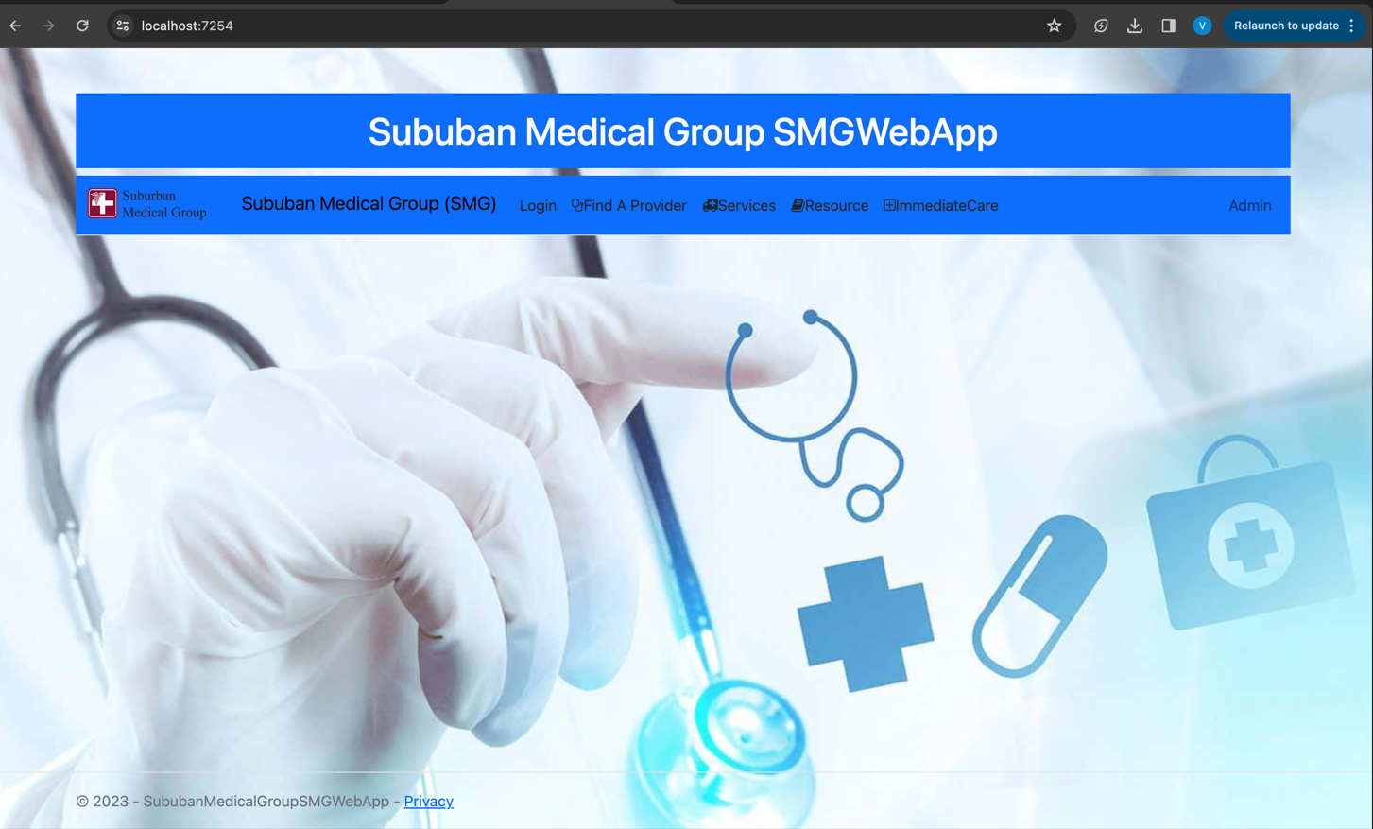
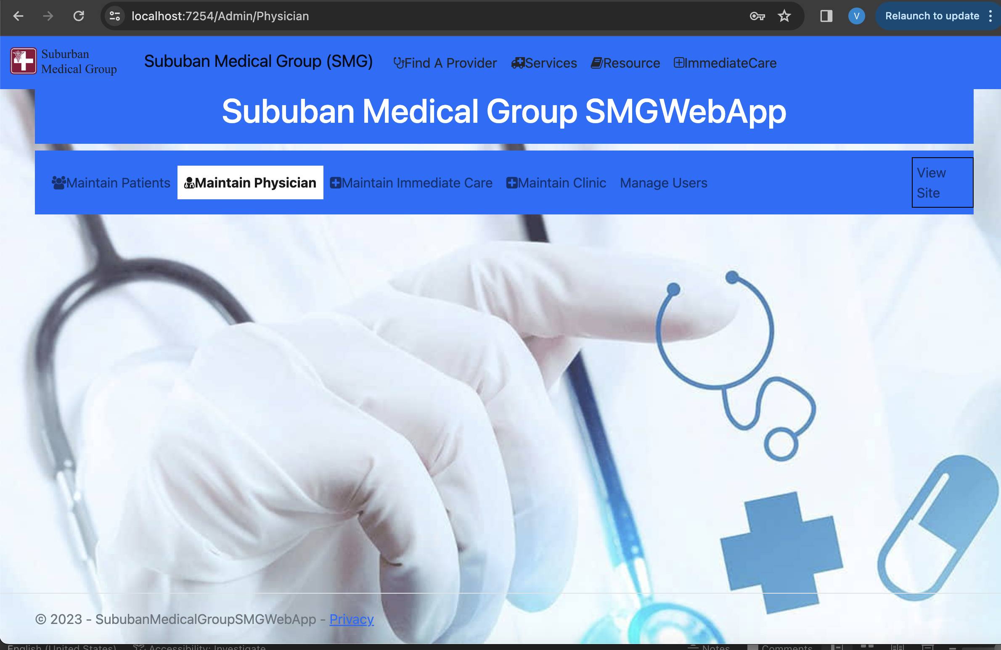
WEB app Design
Welcome Page
Admin Page

Slide 5
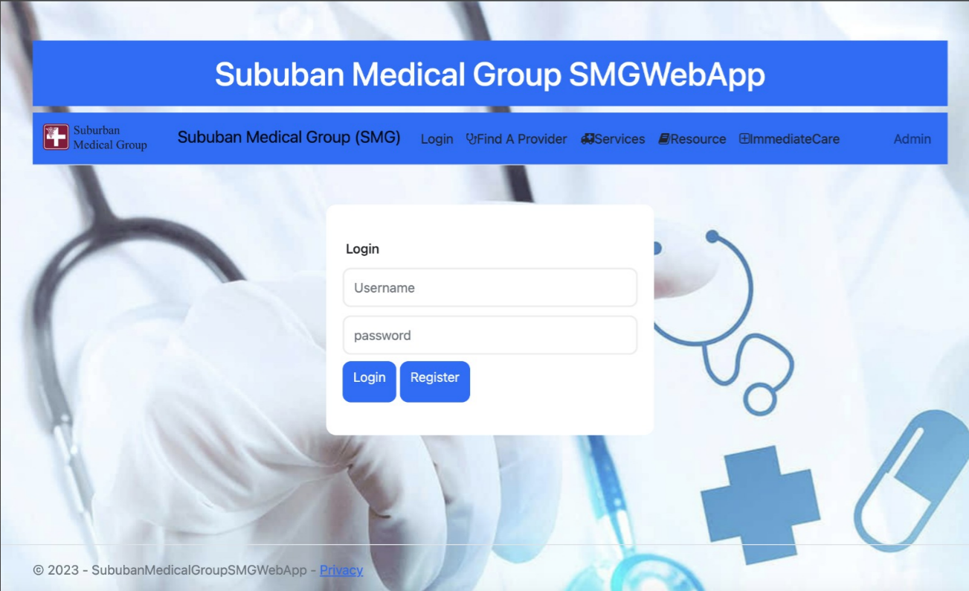
SignIN
User can log in if he is already Registered

Slide 6
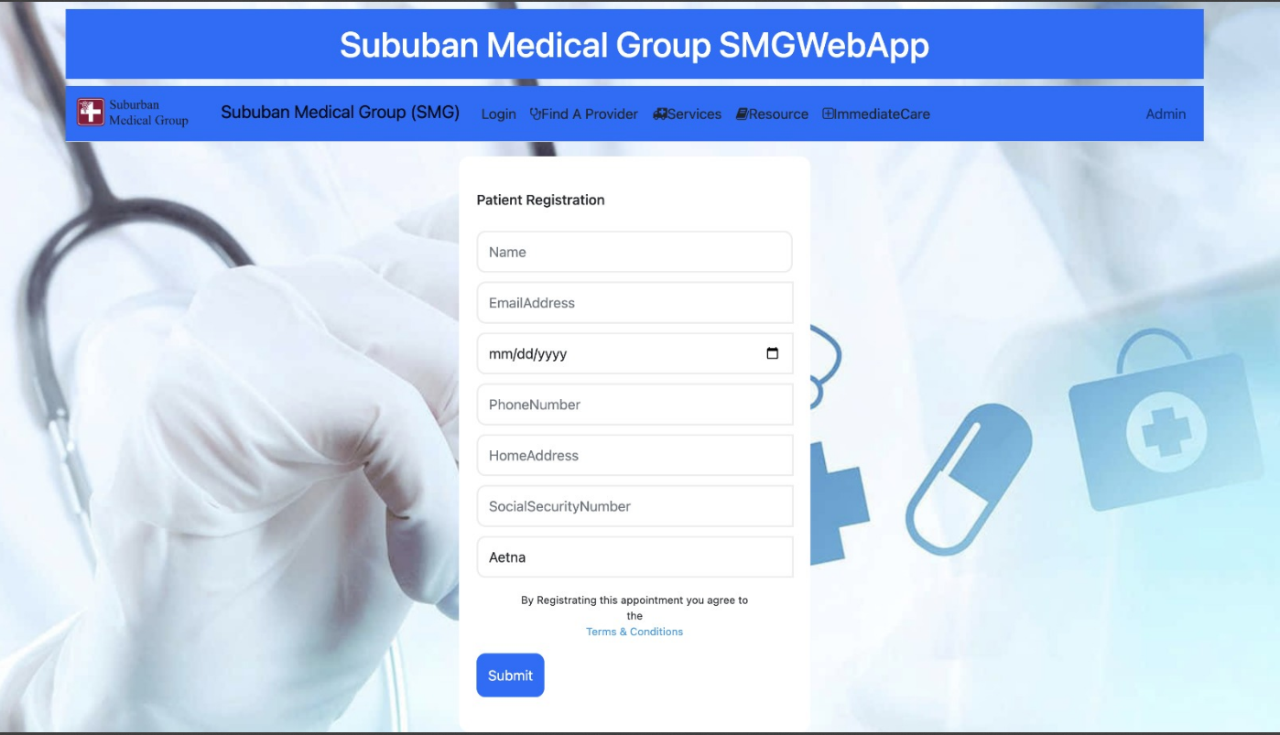
Sign Up
A new User can Register here with Basic Information

Slide 7
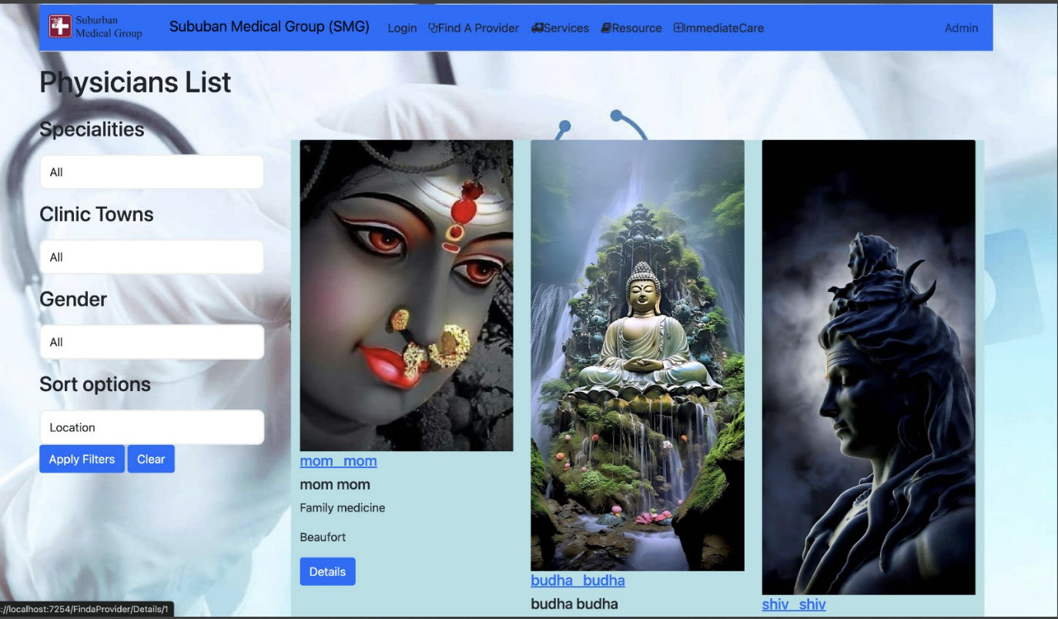
Find A specialist
We can find a physician list and book an online appointment

Slide 8
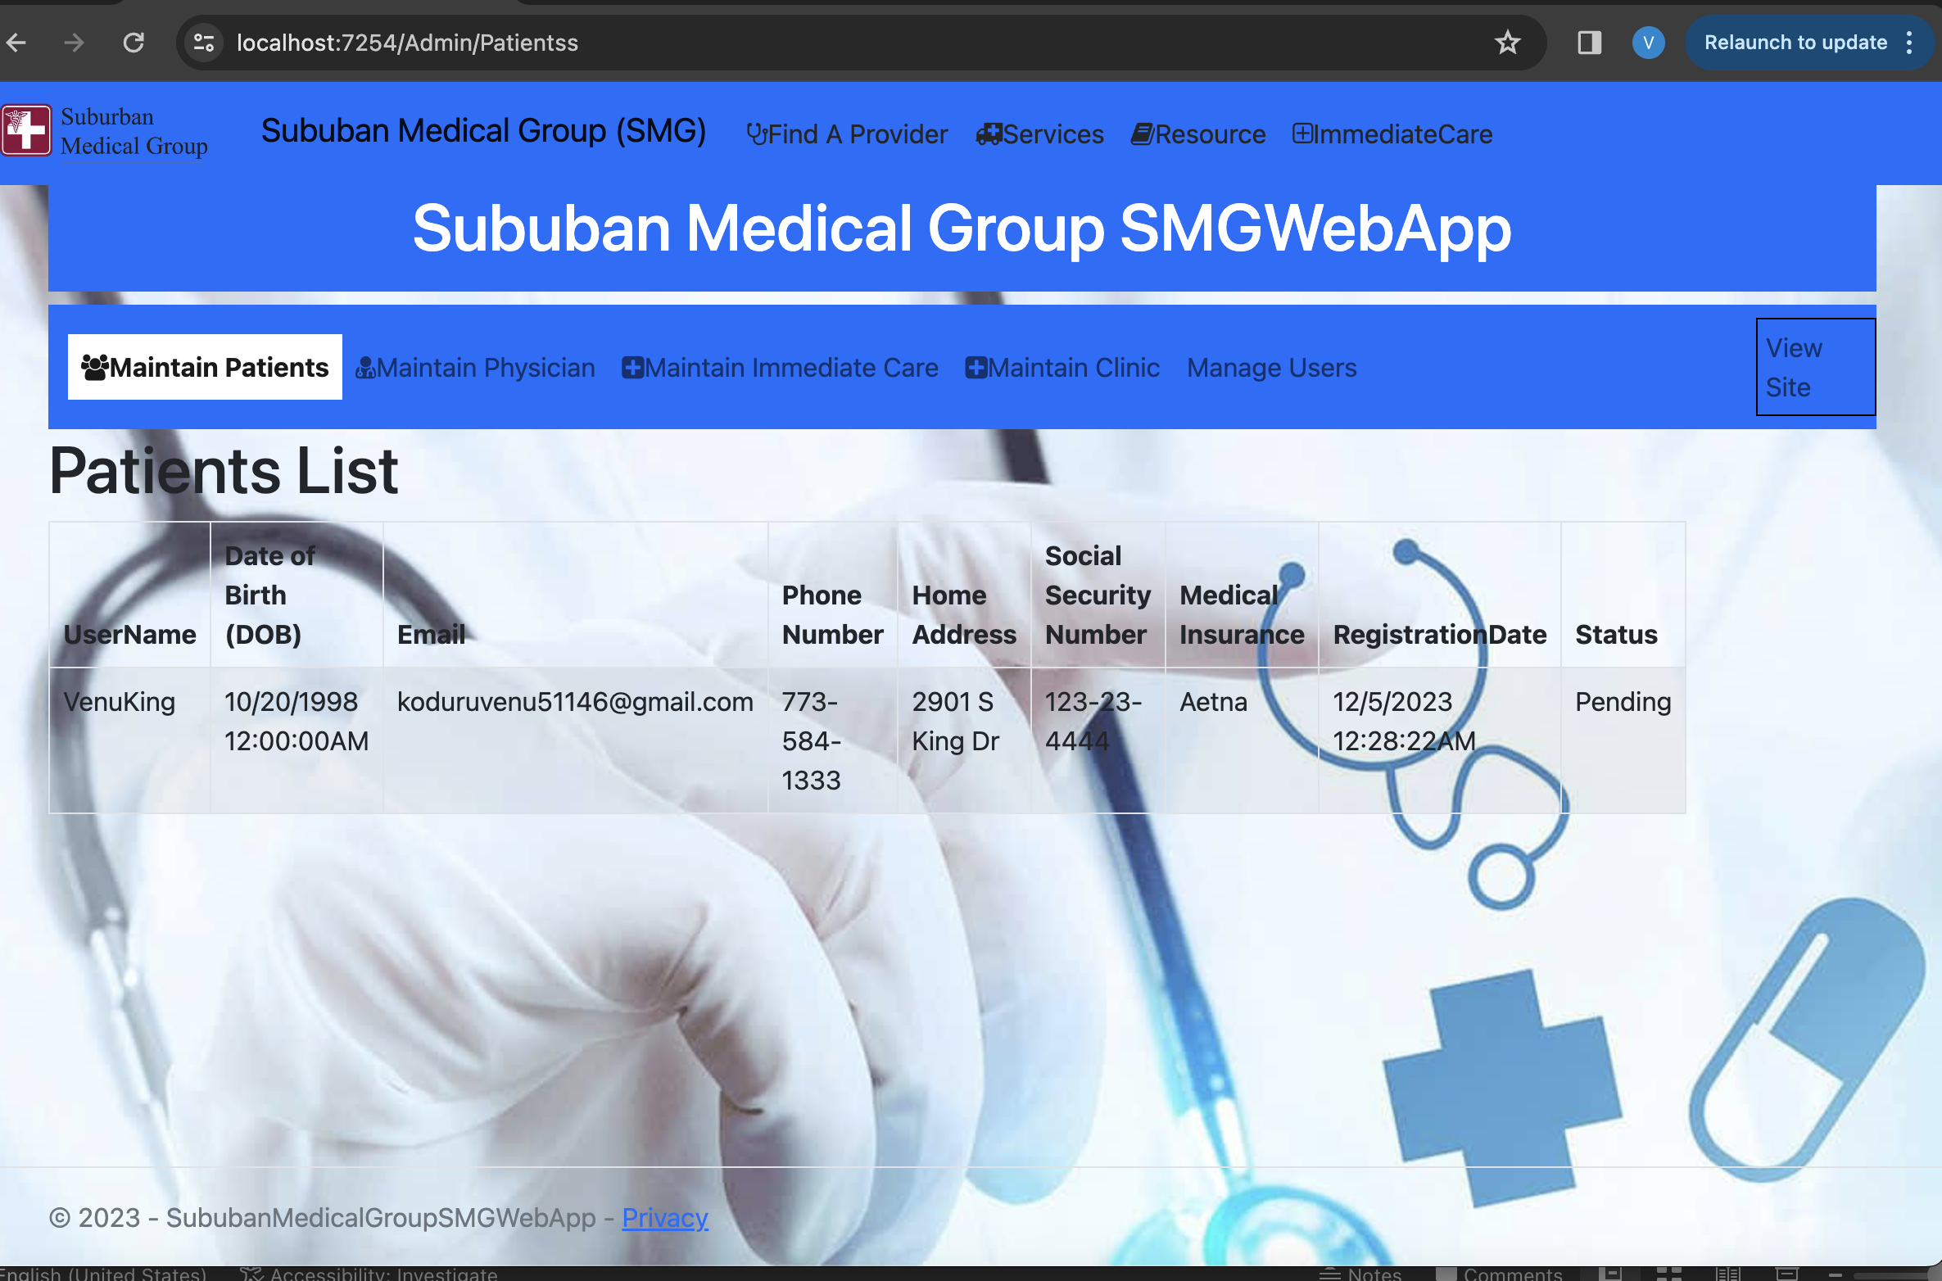
Administration Patients list
Admin has access to maintain the patient’s list

Slide 9
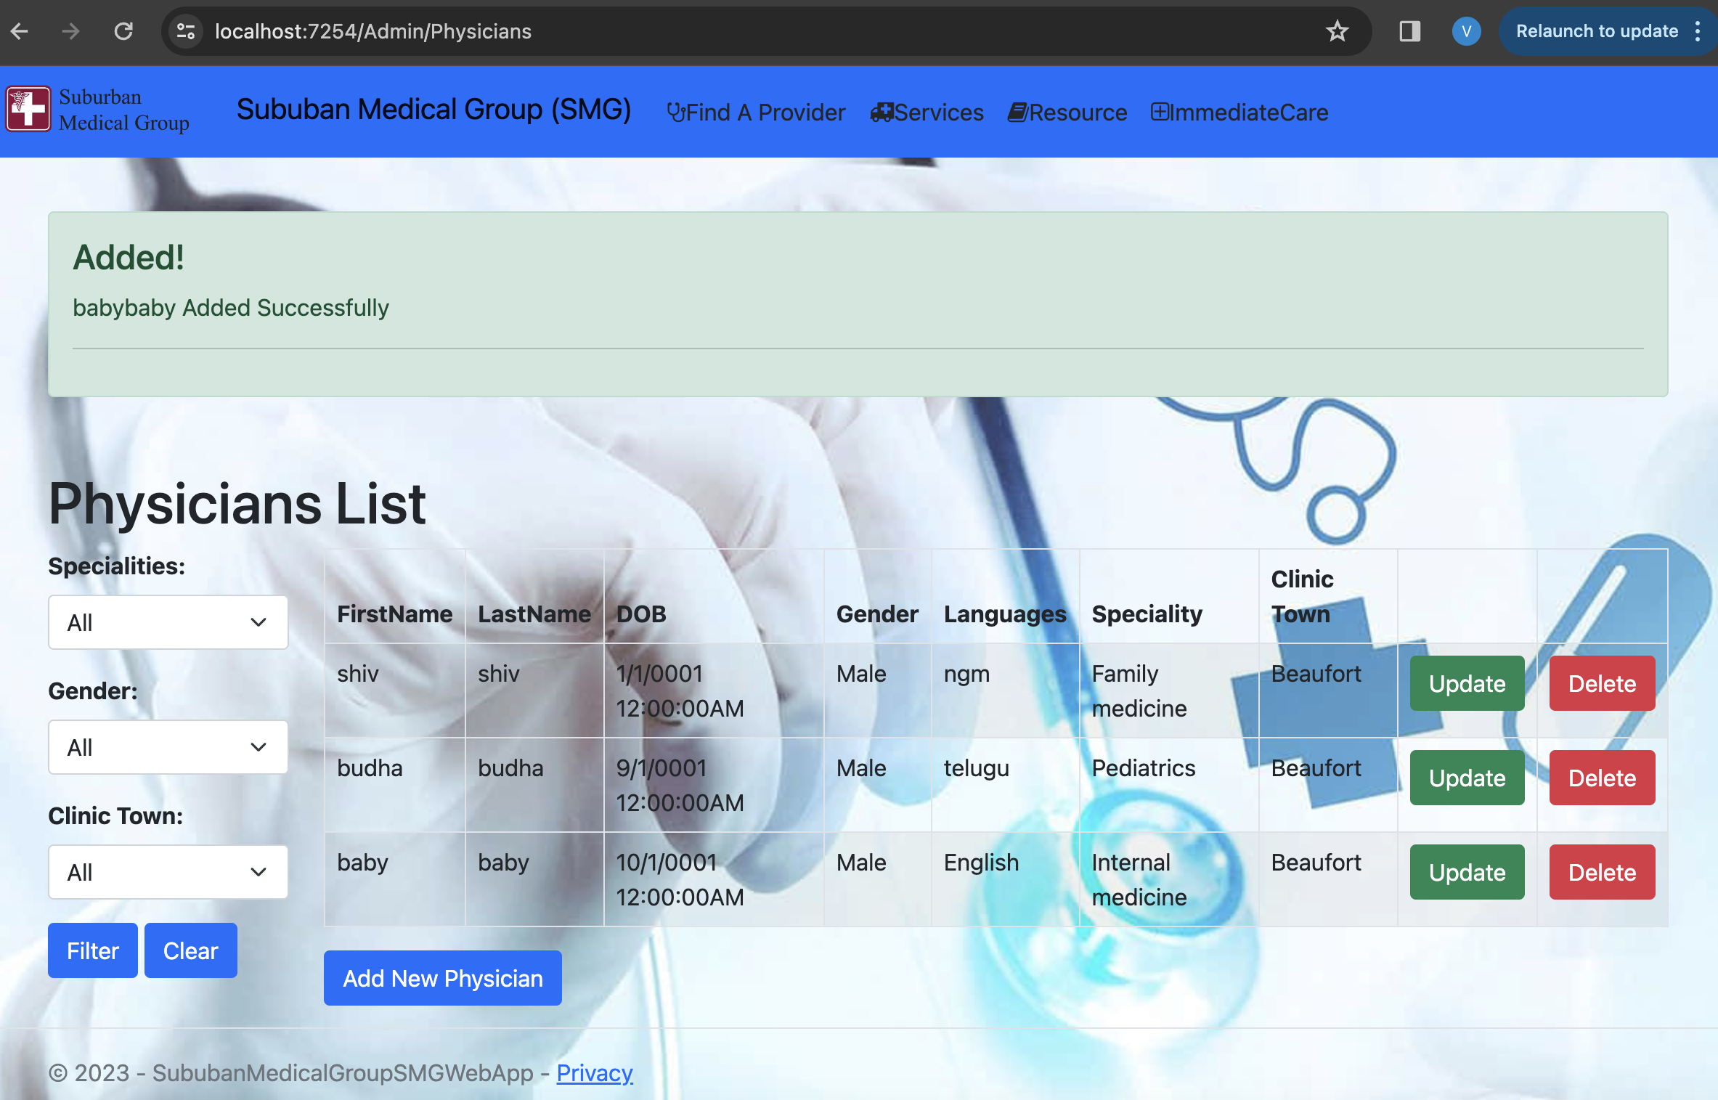
Administration Physicians List

Slide 10
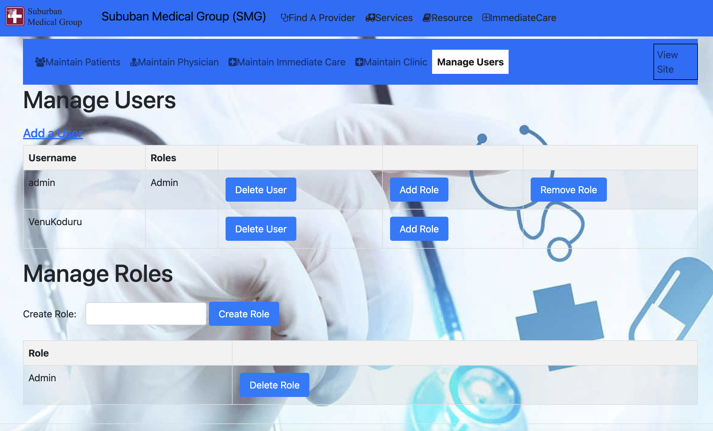
MANAGE USER
In this page Admin has Access to manage users so that he can add and delete the user and he can add role to the user as well as remove the role to the user

Slide 11
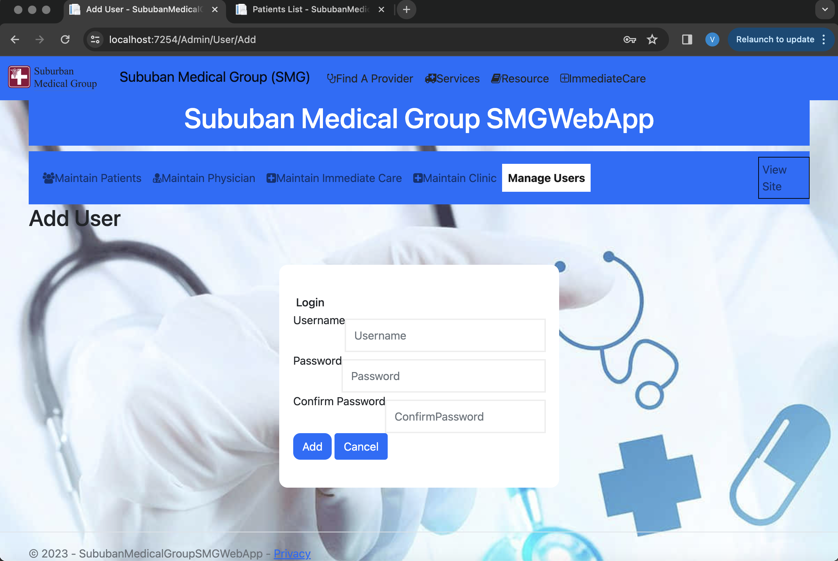
Adding User
Admis can have access to add the users

Slide 12
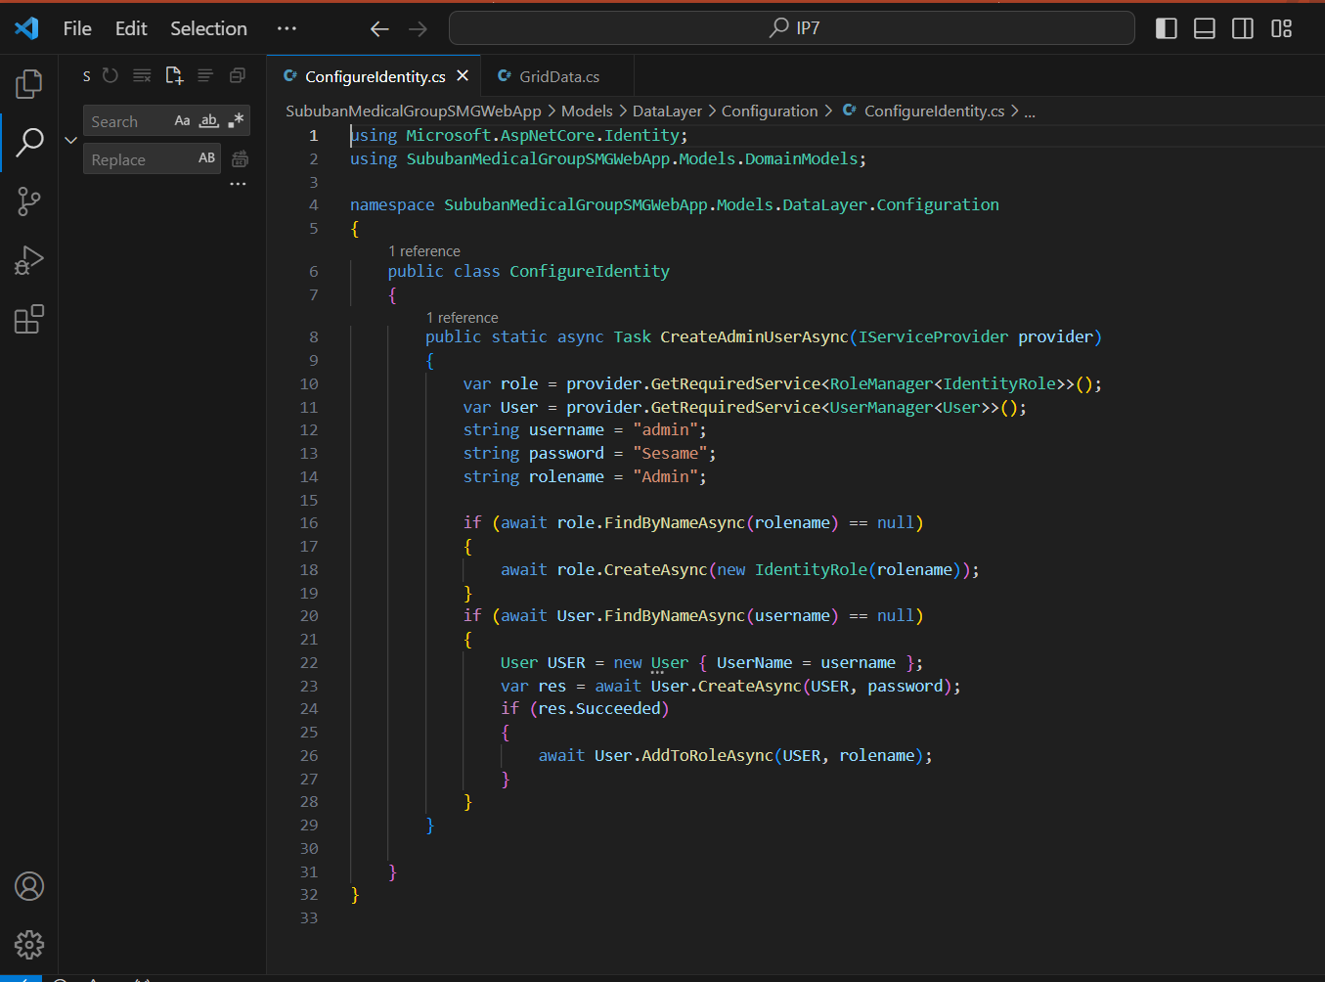
Identity configuration

Slide 13
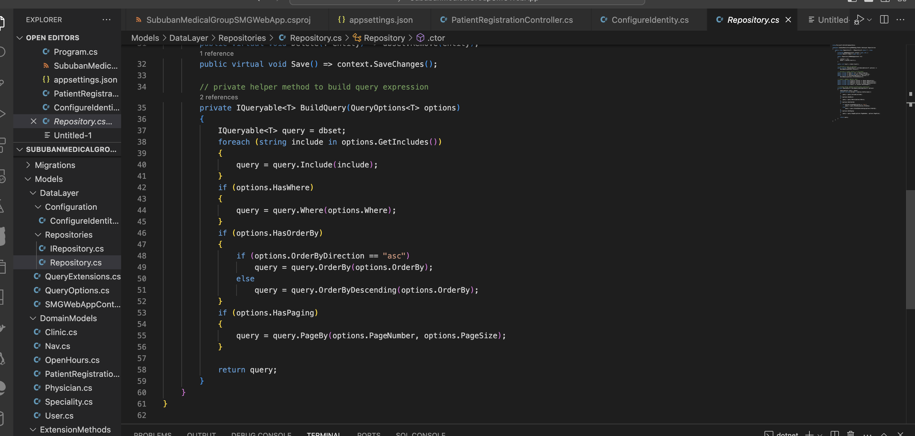
Pagination

Slide 14
Pagination
// Apply ordering
if (options.HasOrderBy)
{
if (options.OrderByDirection == "asc")
query = query.OrderBy(options.OrderBy);
else
query = query.OrderByDescending(options.OrderBy);
}
// Pagination logic starts here
if (options.HasPaging)
{
// Assuming PageBy is an external method or extension method
// Apply pagination using external method
query = query.PageBy(options.PageNumber, options.PageSize);
}
// Pagination logic ends here

Slide 15
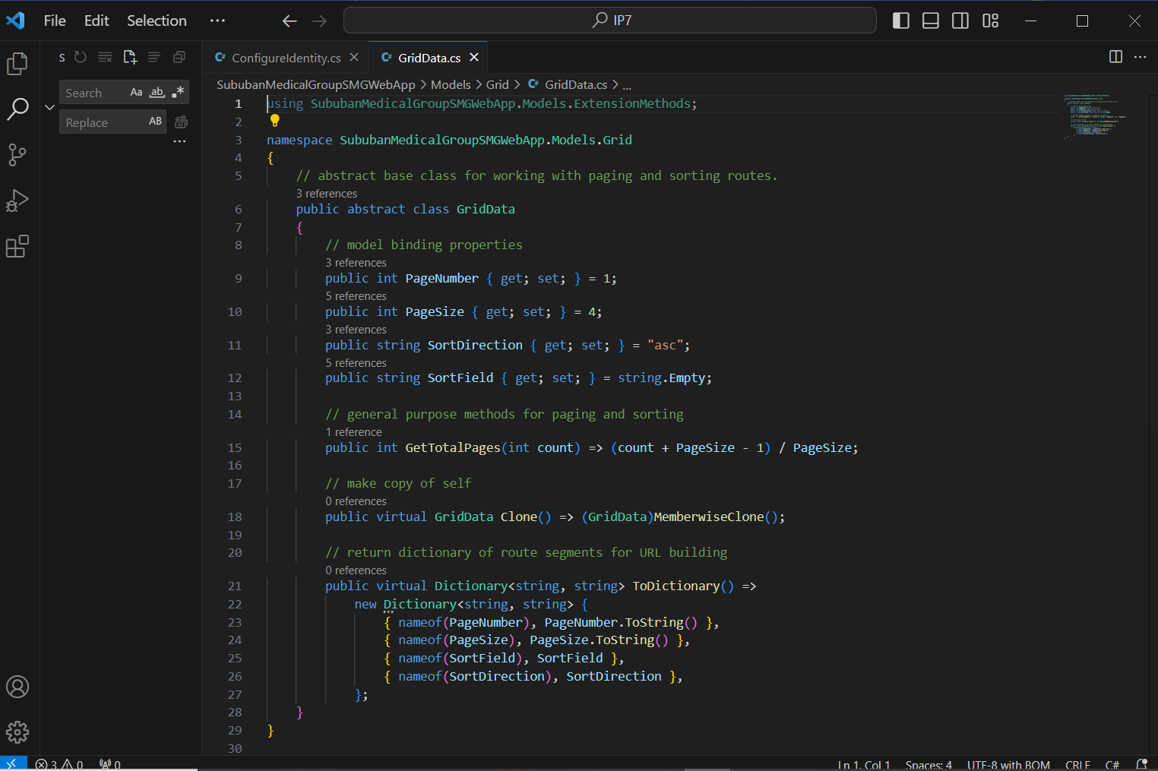
Grid Data

Slide 16
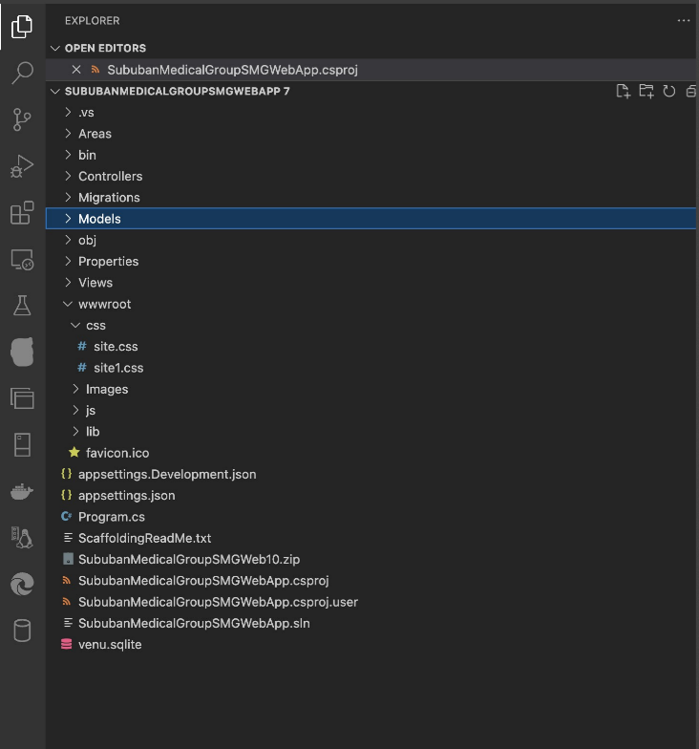
Folder Structure

Slide 17
Question 1
Collaborative Dynamics: In approaching project assignments, our team embraced a dynamic, rotational strategy that fostered a collective effort. Regular meetings were scheduled for interface design and code reviews, ensuring that each team member had exposure to various project aspects. Leveraging collaborative tools like GIT became instrumental in streamlining our progress. This allowed us to maintain version control, coordinate changes seamlessly, and collectively contribute to the project's success. The open communication channels established during these collaborative sessions not only enhanced our workflow but also facilitated a rich exchange of ideas and insights.

Slide 18
Question 2
Navigating Challenges Our 7-week project journey was not without its challenges, and each hurdle presented an opportunity for growth. Whether it was technical roadblocks, conflicting ideas, or time constraints, our team navigated these challenges with resilience and creativity. We overcame obstacles by making informed choices and learning valuable lessons in the process. By maintaining open lines of communication, we were able to address concerns promptly and adapt our strategies when needed. The hurdles, while demanding, ultimately contributed to a more robust and well-rounded project experience.

Slide 19
Question 3
Learning and Growth This project and course have been transformative, providing not only technical knowledge but also shaping my confidence in my chosen field of study. The hands-on experience allowed me to apply theoretical concepts in a practical setting, enhancing my problem-solving skills and critical thinking. The collaboration within the team and the exposure to real-world challenges expanded my perspective and bolstered my adaptability. As I reflect on this experience, it's clear that the lessons learned extend beyond the confines of the project, influencing my approach to future academic and professional endeavors.

Slide 20
Question 4
Favorite Aspects Among the most rewarding moments were the instances where our team achieved milestones and overcame hurdles. These victories underscored the effectiveness of our collaborative efforts and validated the hard work invested. Simultaneously, acknowledging and addressing fears and concerns transparently within the team fostered a supportive environment, allowing us to tackle challenges collectively. The candid discussion of these aspects not only contributed to team cohesion but also added a human touch to the overall project narrative.

Slide 21
Question 5
Course Expectations vs. Reality While the course aligned with some initial expectations, there were notable deviations that added unexpected depth to the learning experience. The practical application of concepts and the emphasis on collaborative projects exceeded expectations, providing a more immersive and holistic understanding. The deviation from a purely theoretical approach was a pleasant surprise, enhancing the overall educational journey.

Slide 22
Question 6
Course Retrospection Upon retrospection, there are aspects of the course that I would consider altering for an even more enriching experience. Adjustments in the pacing of certain modules and the incorporation of more real-world case studies could further bridge the gap between theory and application. However, there are elements, such as the collaborative project structure and hands-on learning opportunities, that I would unequivocally retain as they form the core strengths of the course.

Slide 23
Question 7
Guidance for Aspiring Students To prospective students considering this course, I would advise a thorough exploration of the course structure and alignment with personal learning preferences. Prioritize active participation in collaborative projects, as they provide invaluable practical experience. Adequate preparation in foundational concepts is crucial, but also be open to adapting and learning from real-world scenarios. The ability to communicate effectively within a team and a proactive approach to problem-solving will undoubtedly contribute to a more rewarding learning journey.

Slide 24
Question 8
Online Learning:
In the realm of online learning, fostering engagement and interaction is paramount. Beyond the virtual classroom, creating dedicated spaces for discussions, utilizing collaborative platforms, and incorporating interactive elements into lectures can enhance the overall experience. Encouraging regular communication through online forums or group chats promotes a sense of community among learners. Additionally, providing structured opportunities for virtual networking and mentorship can bridge the gap between the online learning environment and real-world professional connections.

